Slide 1

Mini-Project group-4
Credit Score Classification
Members:
Atharva Shastri
Prakhar Choudhary
Chaitanya Thipse
Rupal Nikum
Prem Chavan
Ashish Bikkad

Slide 2
Overview :
The dataset consists of all the basic bank details of the customers, and the dataset has categorical and numerical variables. It has missing values and more anomalies. It consists of the customer’s bank and processional details over the years so we can explore more of it. You have given the two data sets namely Train and Test datasets. Kindly use the TRAIN dataset to build and test the model. And use the Test dataset to submit your results.

Slide 3
Goals :
Credit risk assessment: The dataset can be used to develop predictive models that assess the risk of default for individual borrowers based on their personal and financial information. This can help lenders make informed decisions about whether to approve loan applications, and if so, what interest rates and loan terms to offer.
Feature importance analysis: By analyzing the dataset, you can identify which features have the most significant impact on the credit score classification. This can help you understand which factors are the most important in determining a borrower's creditworthiness, and can inform decisions about which features to prioritize when developing credit scoring models.
Model comparison: By testing and comparing different machine learning models on the dataset, you can determine which models are the most effective at predicting credit scores. This can help you choose the best model for your specific use case and optimize the accuracy of your credit scoring system.
Portfolio analysis: You can use the dataset to analyze the overall risk and profitability of a lender's loan portfolio. By aggregating information on the credit scores and other characteristics of individual borrowers, you can gain insights into the overall risk level of the portfolio and identify areas for improvement.

Slide 4
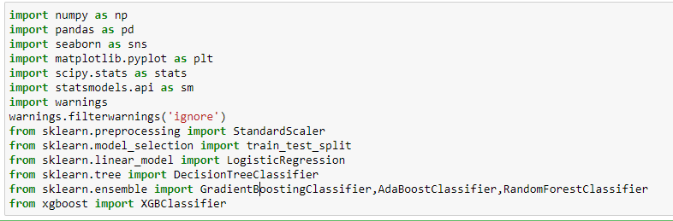
Step 1:Understand the business problem
The management wants to build an intelligent system to segregate the people into credit score brackets to reduce manual efforts.
Step 2: Import all the libraries and set up all the requirements that you will be needed

Slide 5
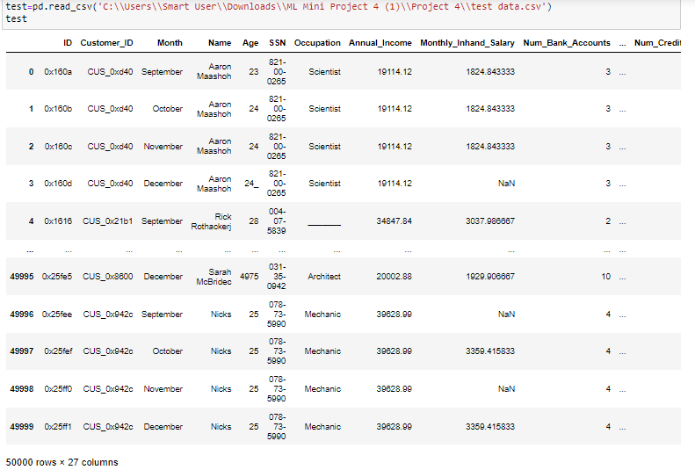
Step 3: Read the train and test data sets, and check for the datatype

Slide 6
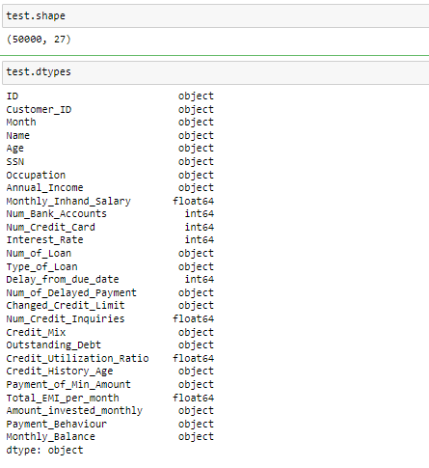

Slide 7
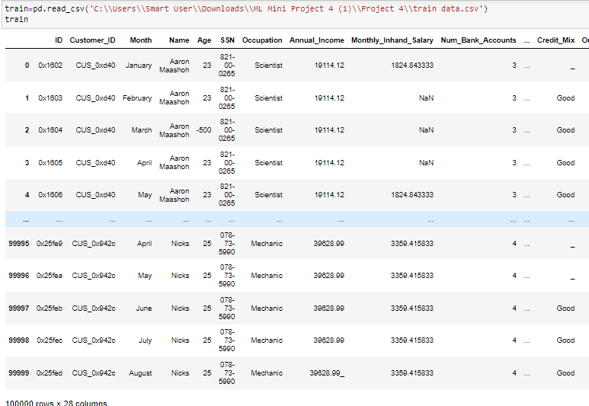

Slide 8
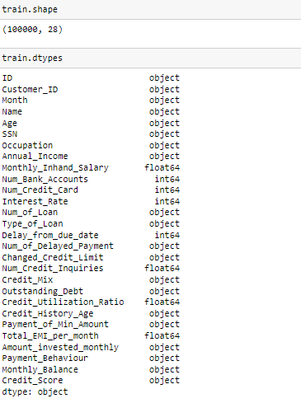

Slide 9
Step 4: Fix the problem that the features have been wrongly identified. Note: One way to clean the training and testing data is to combine both train and test datasets. Then do the cleaning. i) Clean the anomalies in the categorical variables. A few anomalies have been mentioned here.
Occupation - ___
SSN - #F%$D@*&8
Payment Behaviour - !@9#%8 Replace the above anomalies by replacing them with the mode of each customer. ii) Clean the anomalies for numerical variables. Ex:
Age has above 8000 values therefore replace the values that are above 100 or 85 with median values. Note: I encourage you to replace the abnormal values with customer ID-wise median replacement for the customers who have above and below abnormal values. (customer-wise median means the median value for each customer. Example: customer aaa Annual Income has anomaly value in one row so replace that with customer aaa Annual Income median value. )

Slide 10
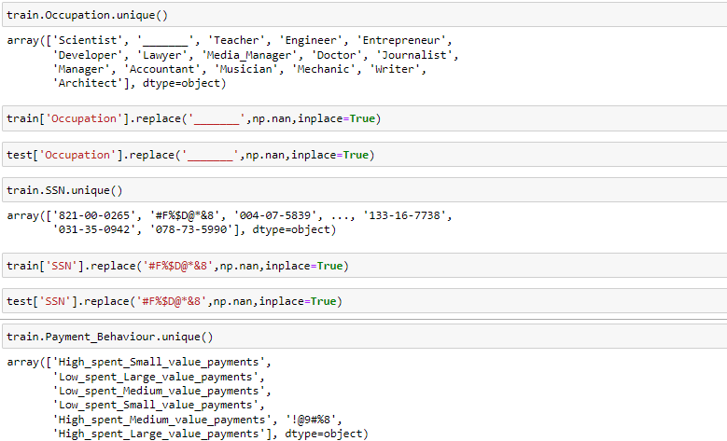

Slide 11
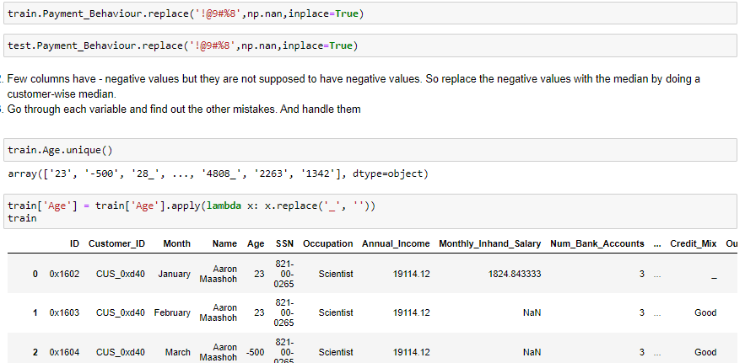

Slide 12
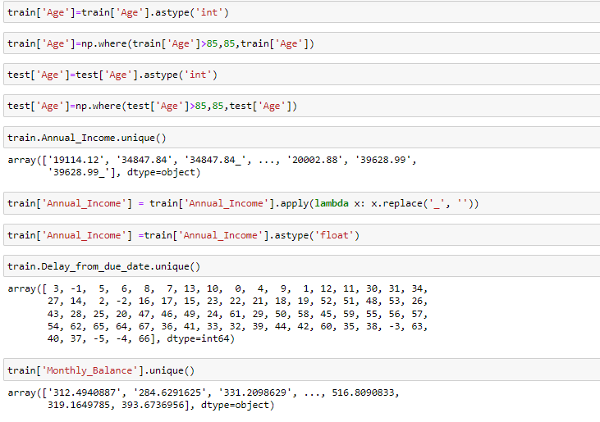

Slide 13
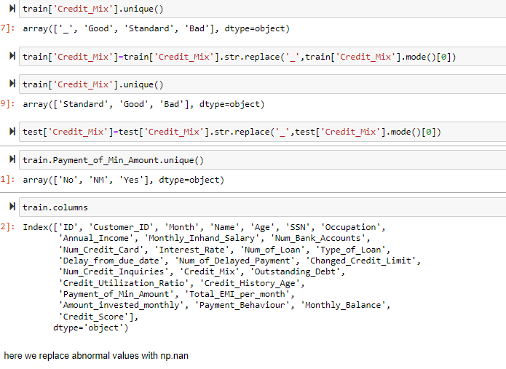

Slide 14
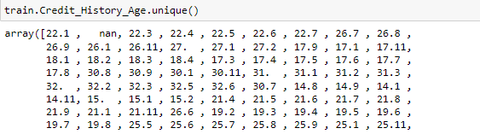
Step 6: Convert the Credit_History_Age datatype variable into float data types by taking only year and month. Example. 22 years and 1 month → 22.1. And the Payment_of_Min_Amount column you might find some other weird values apart from Yes and No. And If you have combined the train and test datasets, then change the month's names into its number Already done this,herehere format was 22 yrar and 1 month we converted to 22.1 by using 'str.replace' and 'str.rstrip'

Slide 15
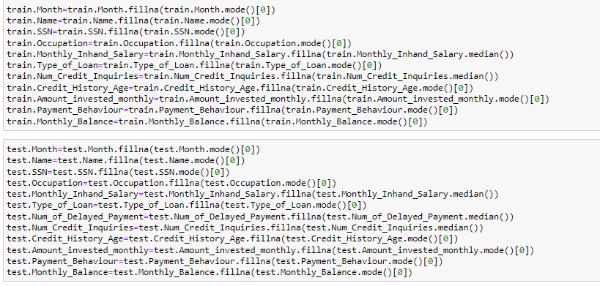
Step 7: Find out the missing values in the data frame and handle them in the best way possible. One way of solving this is by imputing the missing values with a customer-wise median.

Slide 16
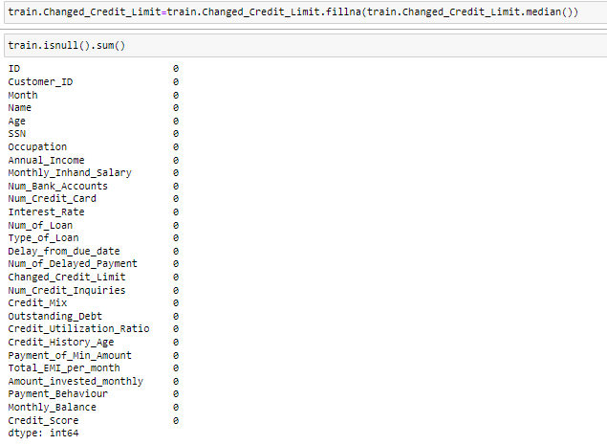
We replace that null value with median when column is numeric and with mode when column is categorical

Slide 17
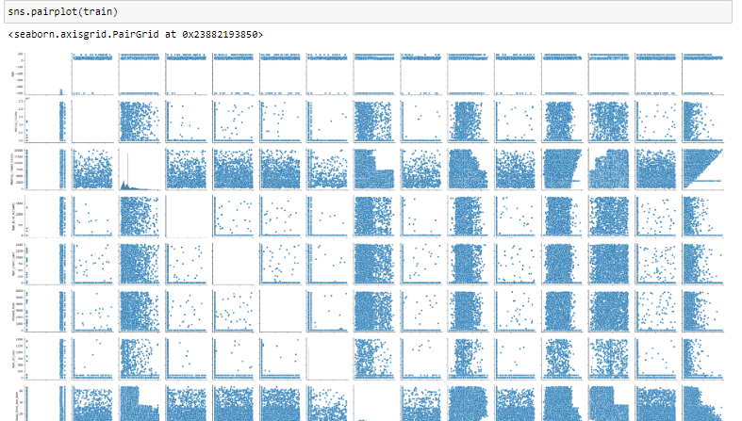
Step 8: Perform Univariate, Bivariate, and Multivariate analyses to find the factors that affect the Target variables.

Slide 18
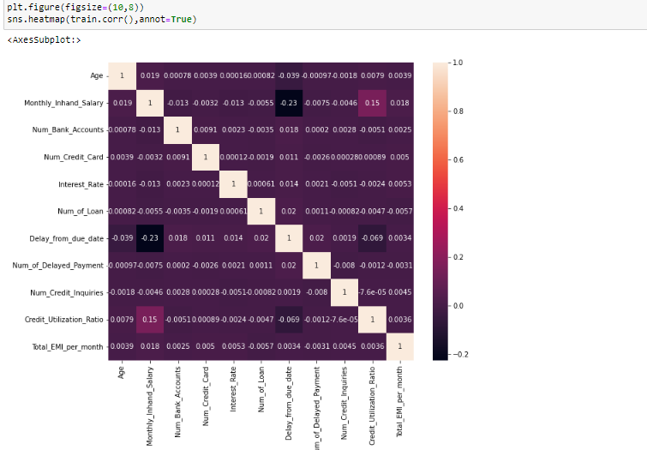
Here we performed uivariate and bivariate analysis by heatmap and pairplot

Slide 19
Step 9: Separate your Train dataset and test data set if you combined them in the initial steps. (In this step only segregate train and test datasets based on the length of the train and test dataset) Note: Your given test dataset is only for validating and submitting the results. Only Use the Train dataset to perform the train test split in the coming steps. Do not use Test to build the model and test the model, Since there is no target variable in the test data set you can not test the model performance with the test data set. Thus we only consider the training dataset and split that into X_train and X_test. Both train and test data are already seperated

Slide 20
Step 11: Perform the Statistical analysis to prove where the independent variables have an effect on the Target variables. Example: Few statistical analyses:
Check whether the Annual income across all the target variables is significantly the same. Let's fix the alpha is 0.05. Make sure the data is normal and the variance is equal. If not use a Non-parametric statistical test.
Check if there is an independence of the Occupation and Credit Score. The significant level is 0.05.
Check if there is a relationship between the Payment Behaviour and Credit Score.
Check Statistically that the Credit_Utilization_Ratio median values significantly not different across the target variable classes.

Slide 21
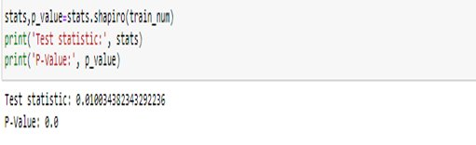
From the above result, we can see that the p-value is less than 0.05 then reject null hypothesis, thus we can say that the data is not normally distributed.

Slide 22
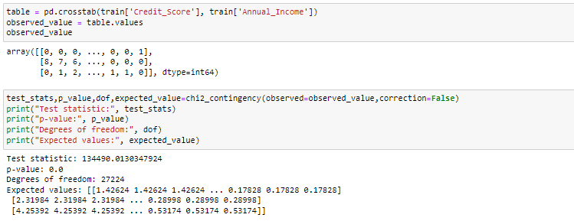
Check whether the Annual income across all the target variables is significantly the same.
Let's fix the alpha is 0.05. Make sure the data is normal and the variance is equal. If not use a Non-parametric statistical test.
p_value is < 0.05 reject the null hypothesis which means the two variables are not independent

Slide 23
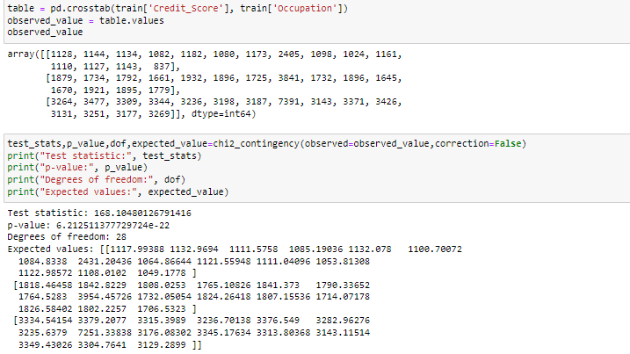
Check if there is an independence of the Occupation and Credit Score. The significant level is 0.05.
As the p_value is > then 0.05 fail to reject null which means the varibles 'occupation' and target varible are independent.

Slide 24
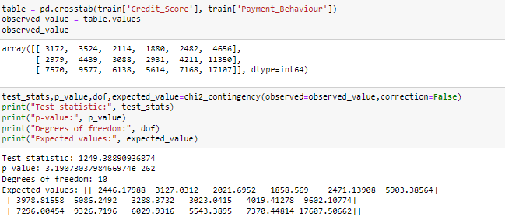
Check if there is a relationship between the Payment Behaviour and Credit Score
As the p_value is > then 0.05 fail to reject null which means the varibles 'Payment_Behaviour' and target varible are independent

Slide 25
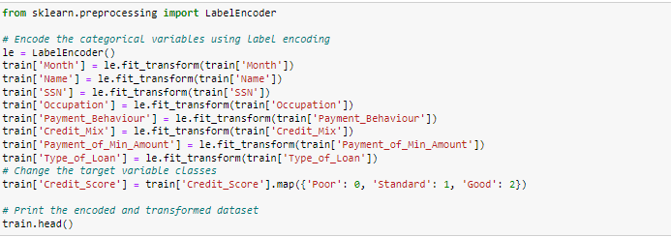
Step 12: Encode the categorical variables with related technologies. Change the target
variable classes as (poor to 0, Standard to 1, Good to 2).

Slide 26
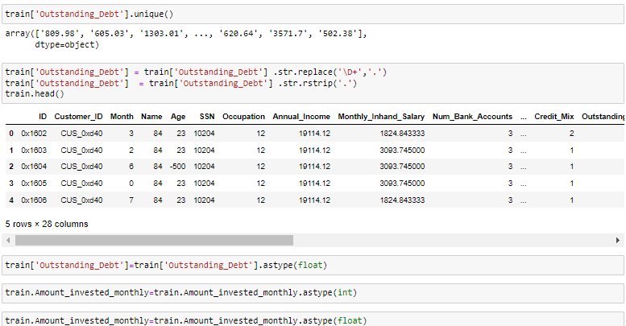

Slide 27
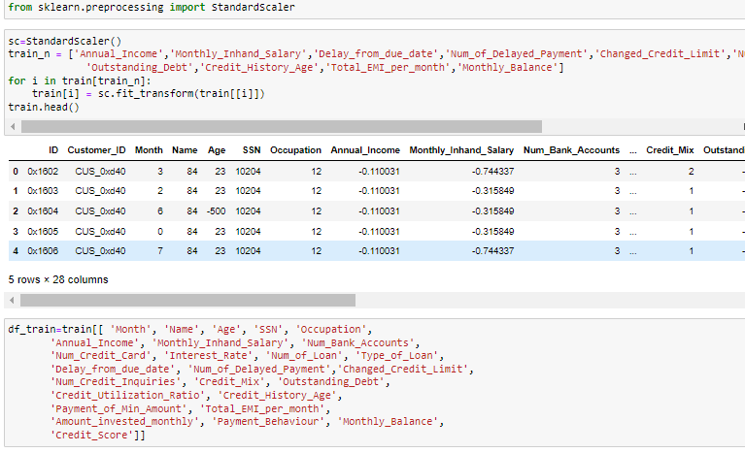
Step 13: Scale the numerical features (optional)

Slide 28
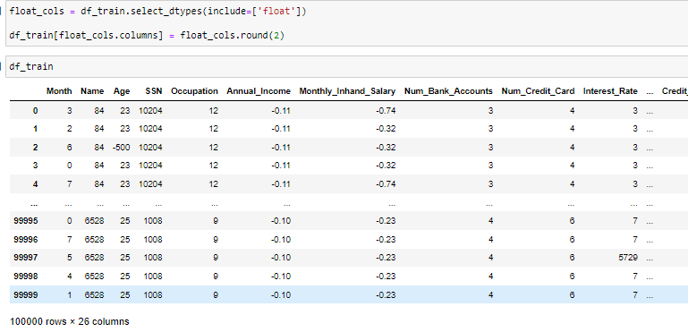

Slide 29
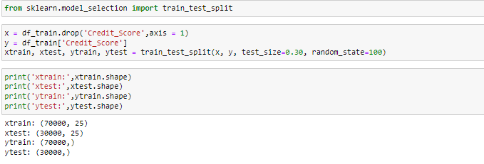
Step 14: Use a train test split on the dataset called a train.

Slide 30
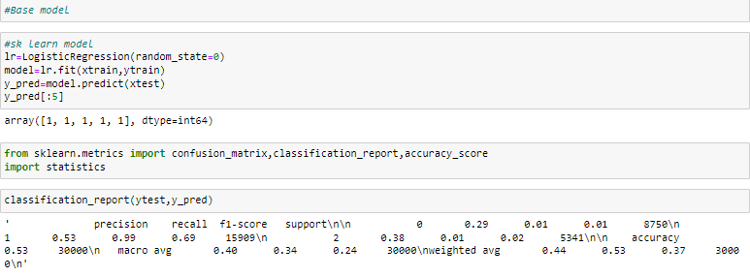
Step 15: Build the base model. Observe how the model is performing.

Slide 31
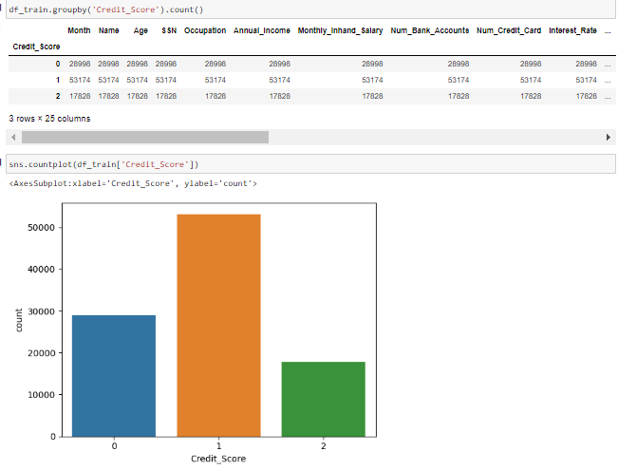
Checking imbalanicing of data: Data is imbalance hence we need to do SMOTE analysis to balance the data

Slide 32
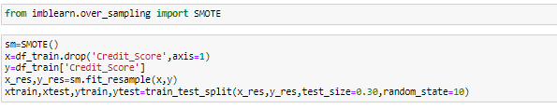

Slide 33
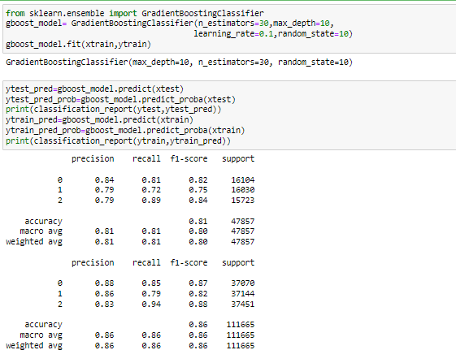
Step 16: Build other models and choose the model which gives the best results.
As the accuracy value is 0.86 we can say that it is good model

Slide 34
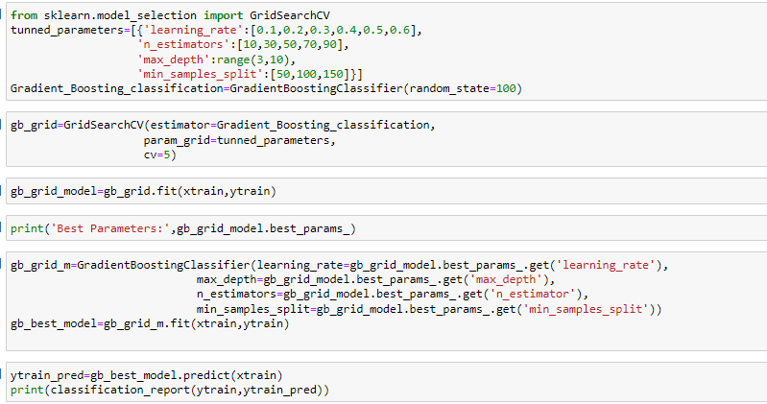
Step 19: Tune the final model using Grid search CV or Randomized CV or any other
methods.

Slide 35
Step 20: Perform Cross-validation for the final model by setting the best parameters.

Slide 36
Business Insight
We saw that the accuracy of the logistic regression model is 0.86. After applying the gradient boosting classifier the accuracy of the model is improved by 2 % that is 0.88.After applying the k fold cross validation for 10 folds the accuracy which we got was 0.85 which is 1% less than logistic regression model.

